Slide 1
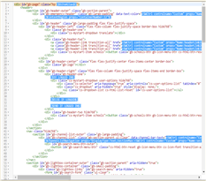
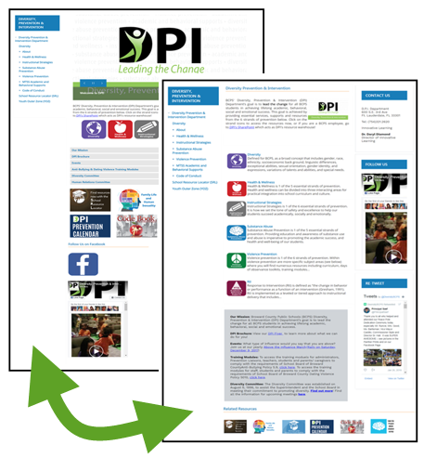
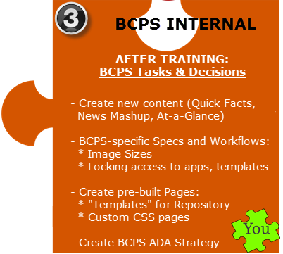
NEXT STEPS
1 Hour Online (Advanced CSS) | 2 Days On Site @ BCPS | 4 Hours Online (Advanced) | Re-organize, CSS, Graphic Design | Launch
App Selection Guidelines
Best Practice Recommendations

